Slide 1

User Interface Design contd.. (Chapter 11- by Roger S. Pressman)

Slide 2
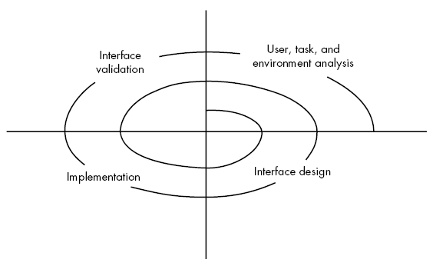
UI analysis & design Process
Iterative process – It uses the spiral process model
Four steps are:
Interface analysis
Interface design
Interface implementation/construction involves prototyping approach
Interface validation
Since its spiral model so these steps need to be processed again and again for design betterment.

Slide 3
UI analysis & design Process
User analysis:
Assess users’ profile who are going to use the system.
Assessment related to skill level, business perception
Define different user categories
Gather requirements for each category & understand system by each category perspective.

Slide 4
UI analysis & design Process
Interface design:
A set of interface objects and actions along with their screen representation that allows user to perform all tasks and fulfil the usability goals of the system.
Interface Construction/implementation:
Create prototype against a use case scenarios & validate the design.

Slide 5
UI analysis & design Process
Interface validation:
Check if the system accommodates all variety of tasks?
Whether the system is easy to use & learn?
users’ acceptance of a system as useful tool
Now, we’ll cover each separately in detail

Slide 6
Interface Analysis
User Analysis:
Understand problem before designing the solution.
Understand users of the system,
the system goals (tasks),
the displayed content,
the environment in which tasks is conducted.
The mental image and the design model must converge.
Can be achieved by understanding the users and how they use the system

Slide 7
Interface Analysis
Information for system understanding can be obtained by:
User interviews
s/w team members met with end users to identify their needs and work culture.
Sales input
Sales people meet with users to assess the user categories & understand req.
Marketing input
Take the market survey and check in how many ways the product could come handy.
Support input
Support staff takes feedback of the what work or what not. Which features are easy to use or not etc.

Slide 8
User Analysis questions for better user categorization
Are users trained professionals, technician, clerical, or manufacturing workers?
What level of formal education does the average user have?
Are the users capable of learning from written materials or have they expressed a desire for classroom training?
users expert typists / keyboard phobic?
age range of the user community?
User’s gender?
How are users compensated for the work they perform?
Working hours: normal office hours / until the job is done?
Software usage frequency ? (mostly/occasionally)
primary spoken language among users?
consequences if a user makes a mistake using the system?
Are users experts in the subject matter that is addressed by the system?
Are users interested in learning about the technology that sits behind the interface?

Slide 9
UI analysis & design Process
task analysis:
Detailed task analysis done after interface analysis.
The tasks that users will perform to accomplish system goals.
User environment analysis:
done to check if the current physical environment be able to cater the system needs?
Output: Analysis model for interface

Slide 10
Interface Analysis
Task Analysis & Modelling
answer the given questions the following questions …
Task identification in specific circumstances.
Tasks and sub tasks performed by user
sequence of work tasks—the workflow
Use-cases:
define basic interaction of actor and system
written using informal paragraphs.
Can be used to derive tasks, sub tasks and interfaces
Task elaboration:
Stepwise elaboration or task refinement of interactive tasks
Derive either manually or use a preexisting system to identify them
Object elaboration:
extract physical objects from system to define their classes and behavior
Workflow analysis defines how a work process is
How a work process is completed when several people (and roles) are involved
Shown using UML swim line diagram

Slide 11
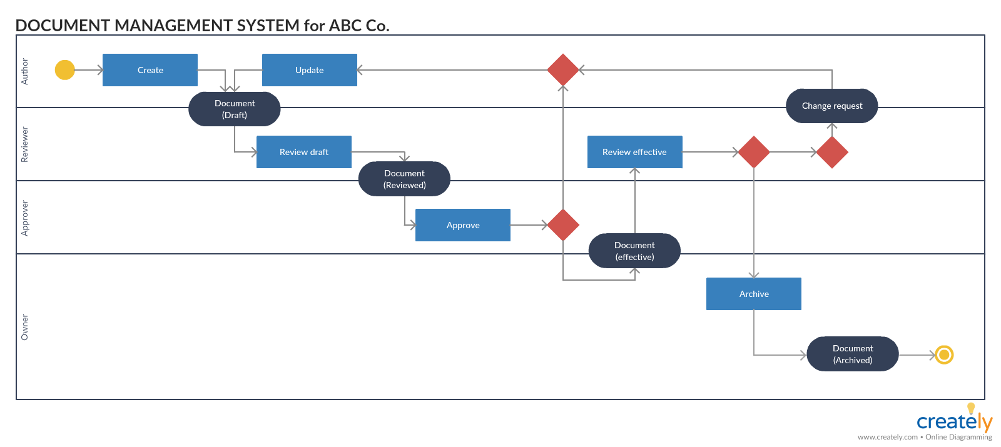
Interface Analysis
Task Analysis & Modelling
Swim lane diagram

Slide 12
Interface Analysis
Analysis of Display Content
Format of the content
Aesthetics
Content displayed using stepwise refinement approach
Analysis of Physical Work Environment
Work environment should be helpful in proper operation and concentration .
Must co-relate with the designed software aesthetics.

